Slide 1

IRIS TUMOR DETECTION USING CNN
TEAM MEMBERS:
Preethi
Sowndarya Nandhagopal

Slide 2
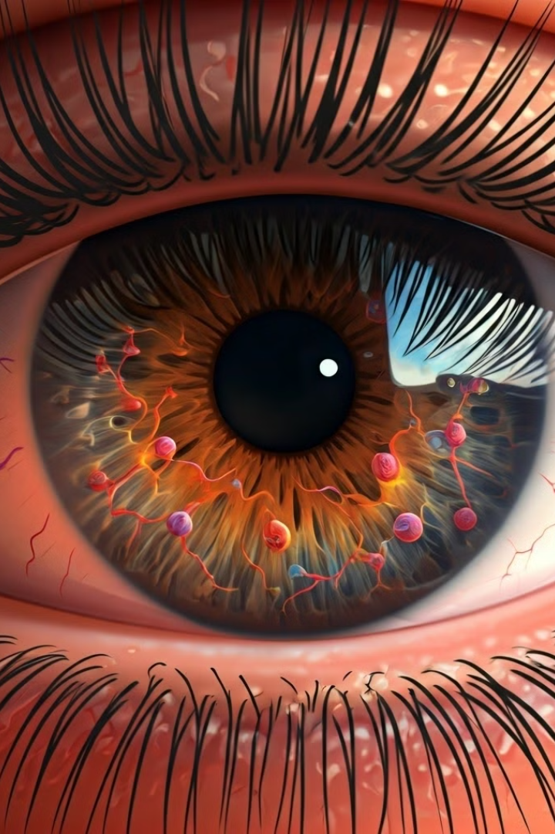
Iris Tumor Detection Using Convolutional Neural Networks
Introduction :
This project focuses on developing a deep learning model to detect tumors in iris images using Convolutional Neural Networks (CNN).
Traditional methods of detecting iris tumors can be time-consuming and dependent on specialist analysis. This project aims to automate detection using Convolutional Neural Networks (CNNs) to make the process faster, more consistent, and more accessible.
In this project, a CNN model is trained to identify and classify iris tumors from medical images, improving detection accuracy and aiding in early diagnosis.

Slide 3
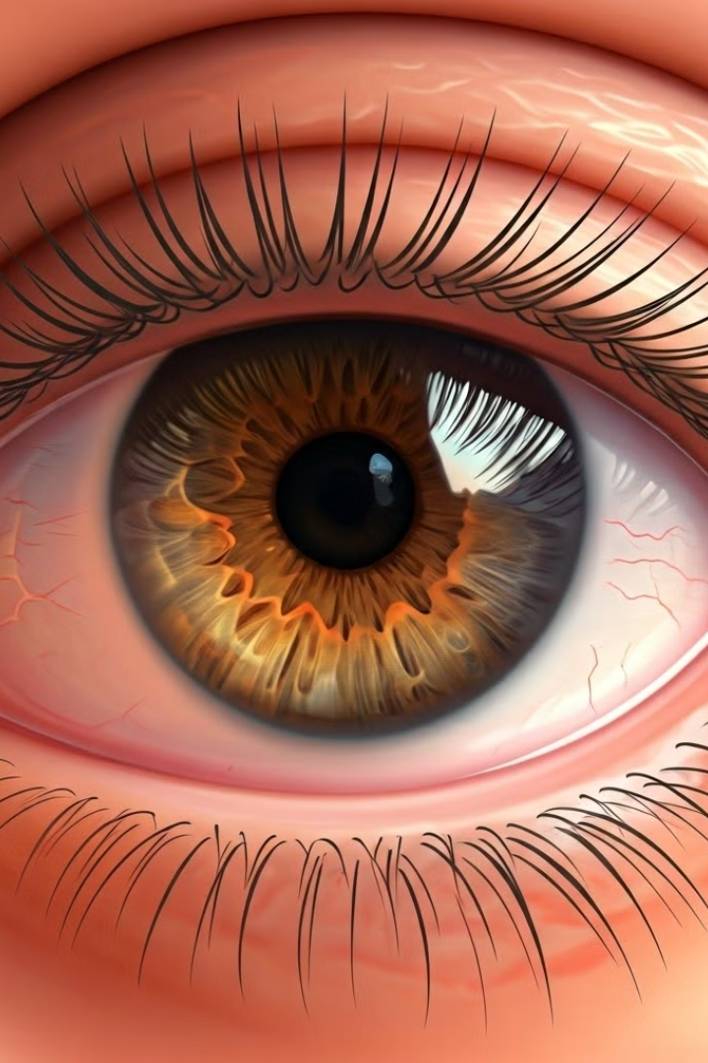
Project Overview
Customer features :
Register page :New username and password for successful registeration
Login page : login with username and password
About page : Giving the mission and vision about the project
Uploading file: uploading the file to detect the tumor
Detecting tumor : the model detect the tumor and show the output

Slide 4
User-Friendly Features :
Sucessful registration with new username and creating password with minimum of 8 character including special character like @,/,_,.+,- and the password can’t be entirely numeric
Secure Logout Option for allowing user to securely end their session and convenient and reliable enhances user experience by giving users control over session duration.
Technology used :
Programming Languages: Python
Development Environment: VS Code
Libraries and Frameworks: TensorFlow, Keras, OpenCV (for image processing)

Slide 5
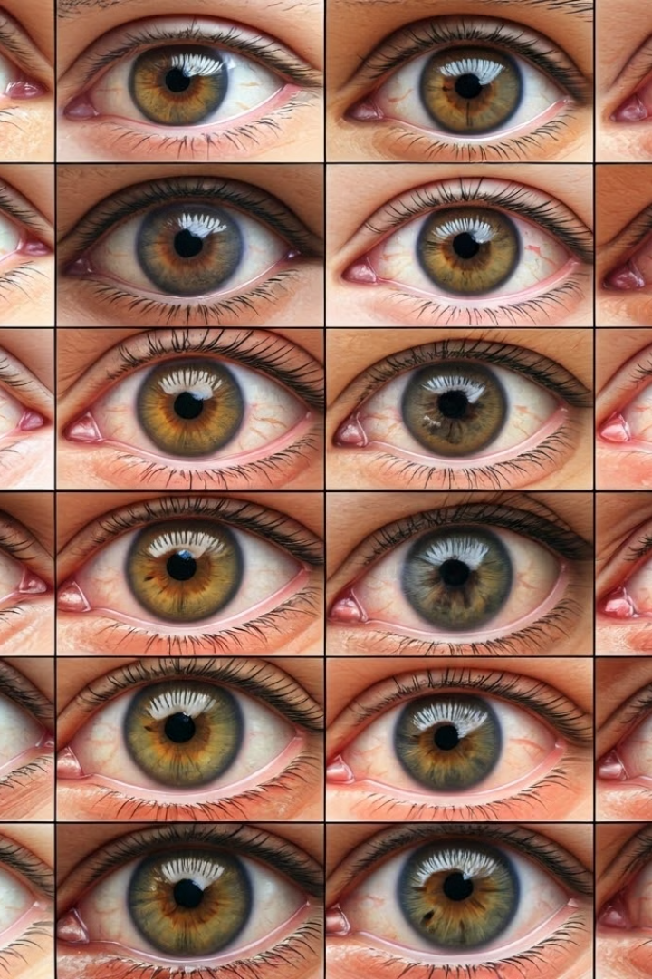
Milestone:
The Registration and login page allows new users or technicians to create an account in the system
Allow the user to uploads an image of the iris, typically in a standard format (e.g., JPEG, PNG,).
User-Friendly Design by easy navigation with a clean, straightforward layout, minimal steps and quick Processing .
The CNN model achieved 92% accuracy on the test dataset.
The high accuracy suggests that CNNs are effective in detecting iris tumors from images.

Slide 6
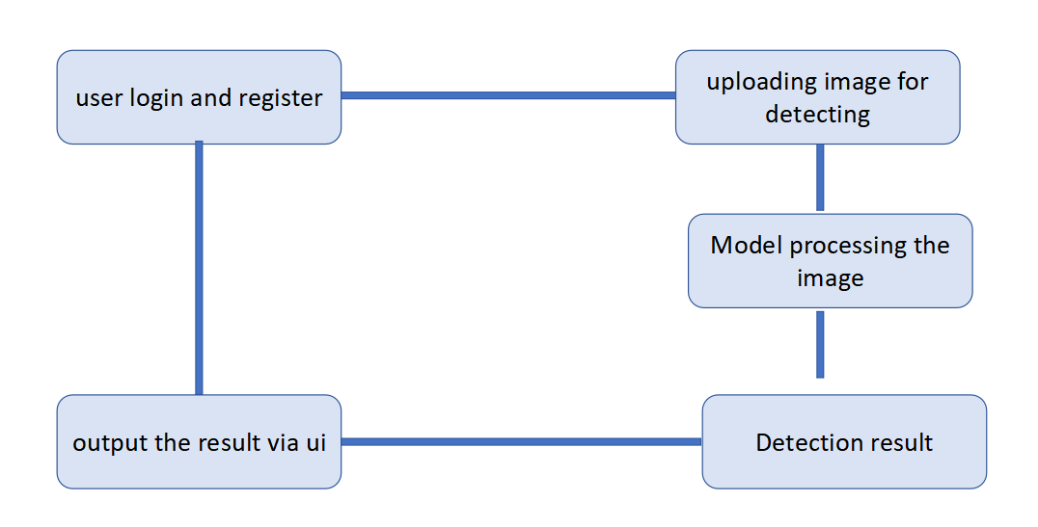
CLASS DIAGRAM :

Slide 7
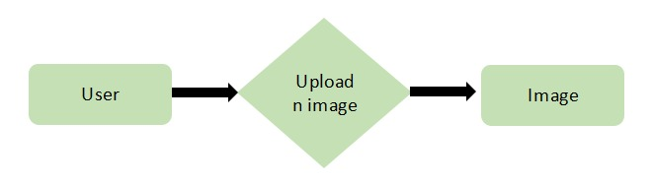
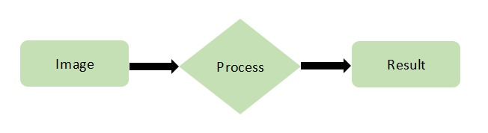
ü User to Image:
One-to-Many (One User can upload multiple Images)
ü ✓Image to Result:
One-to-One (One Image has one corresponding Result)

Slide 8
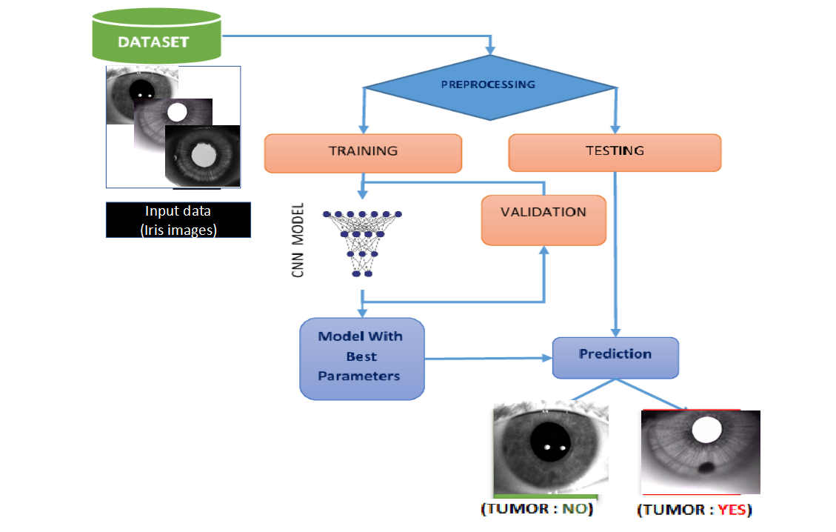

Slide 9
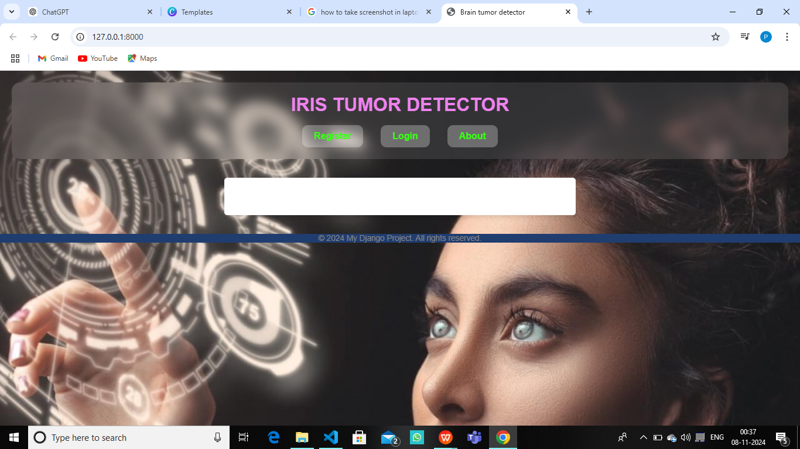
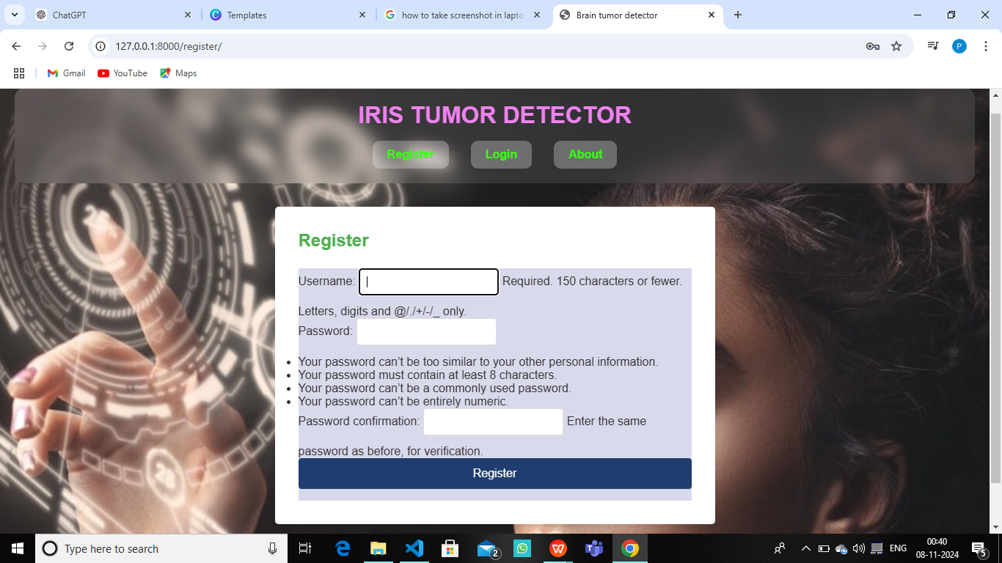
login and register

Slide 10
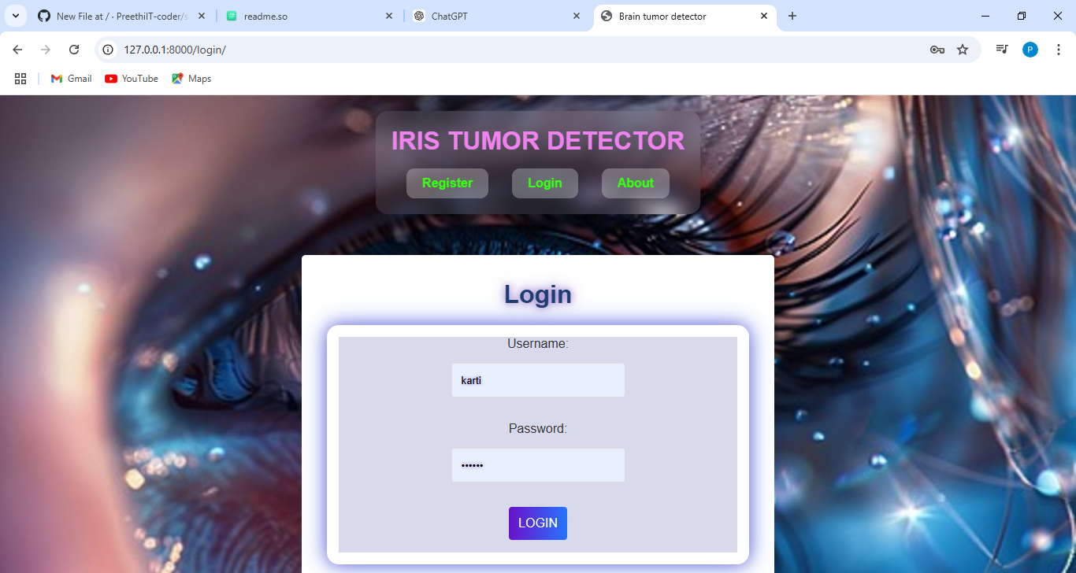
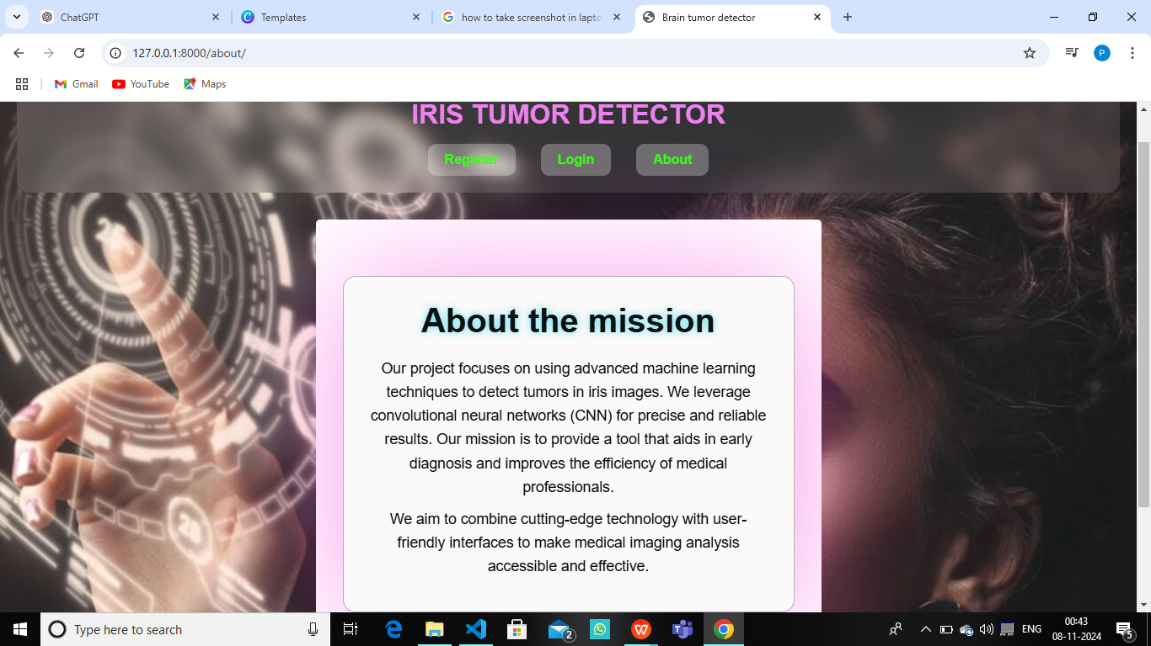
About the project

Slide 11
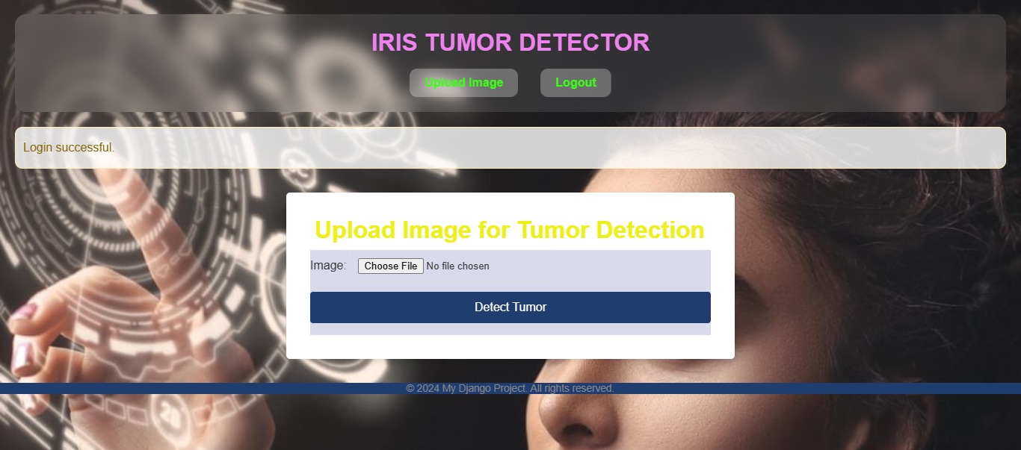
File uploading page

Slide 12
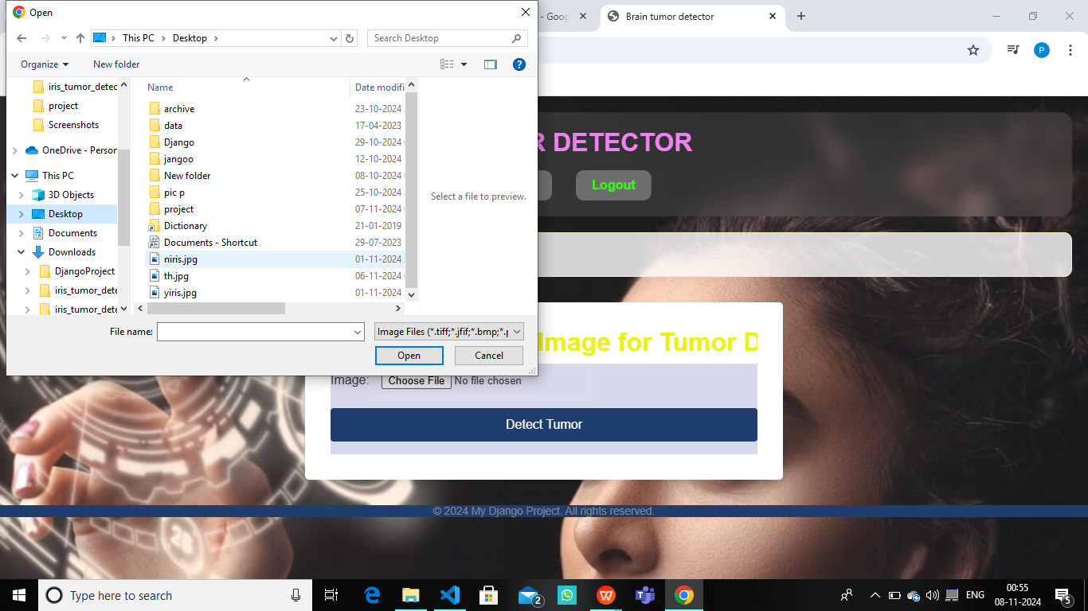
choose the file to upload

Slide 13
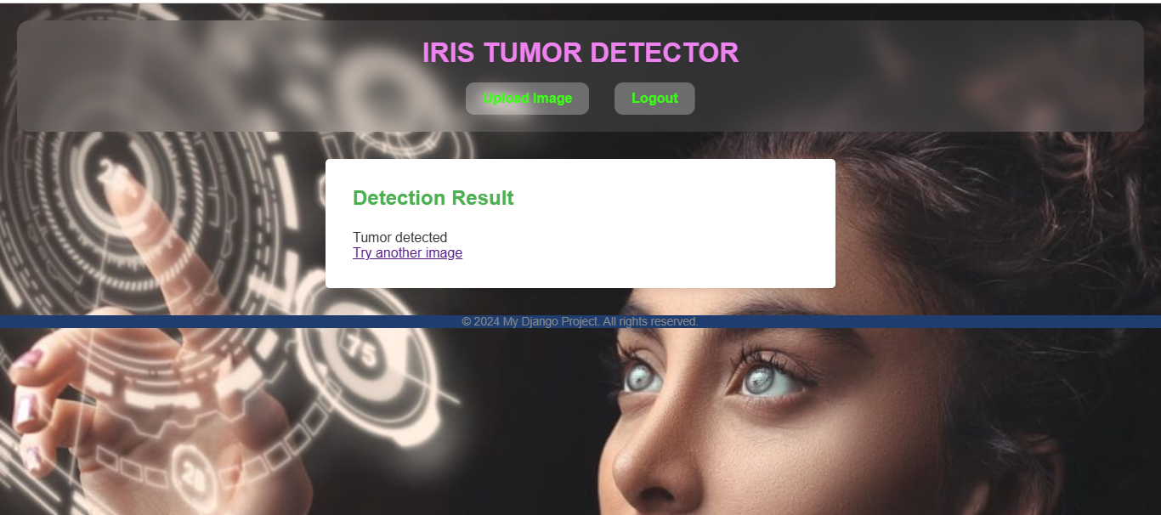
output to user if the iris having the tumor

Slide 14

output to user if no tumor is detected

Slide 15
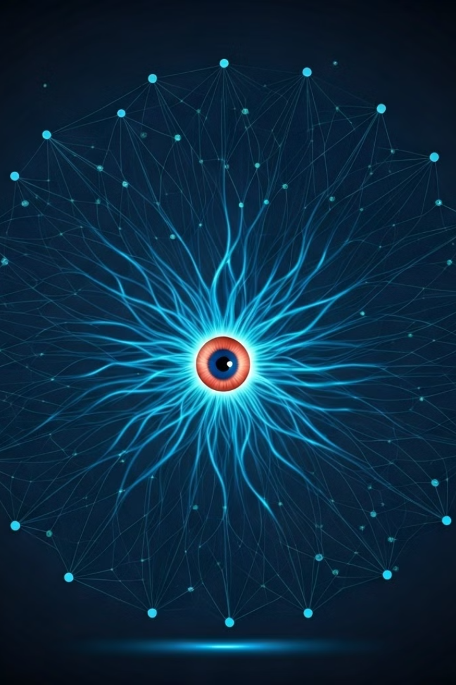
Conclusion and FutureScope :
Summary of Achievements:
This project demonstrates how CNNs can effectively detect iris tumors, achieving high accuracy and reliability.
This system offers healthcare professionals a valuable tool to streamline tumor detection, ultimately aiding in timely medical intervention and improving patient outcomes
Future Scope:
Extend the model to detect other types of eye tumors.
Deploy the model as a web application for broader accessibility.

Slide 16


